Slide 1




Next Gen Employability Program
Full Stack Web Development with AI Tools
Team Details:
Team ID: NG_CP_Team_5140
Team Members Name:
Nithiya B
Gopika N
Pavithra V
Shalini M
College: Adhiparasakthi Engineering College, Chennai

Slide 2

The content is curated from online/offline resources and used for educational purpose only.
Notes:
Speaker would be briefing the students that this content has been prepared for the educational purpose only and is referred from multiple sites which are cited in the last.​​
---------------------------------------------------​​
A disclaimer is a statement or notice that is intended to clarify, limit, or provide information about the scope, limitations, or potential risks associated with certain actions, information, products, services, or content. ​​
​​
​

Slide 3

Project Title
PROJECT IDEA SUGGESTION SYSTEM - itactuallyworks
Notes:
In this slide speaker will be introducing the program and its outcomes. The speaker will introduce himself in brief

Slide 4

Table of Contents:
Problem Statement
Existing System
Objectives of Our Solution
Introduction
Requirements
Modules
Home page
Login Page
Dashboard
Future Enhancement
Conclusion
Reference
Notes:
This slide, The speaker will talk about the content that we will be covering in this session as follows:
Introduction
Importance of UI/UX in industry
History and Definitions of UI and UX
Key Differences between UI/UX
Use Cases
Significance in Web Development
Use Cases
Visual Design Principles
Design process
Color theory and psychology
Typography and readability
Layout and Spacing
Responsive design basics
Usability and Accessibility
Usability Aspects
Web Content Accessibility Guidelines (WCAG)
Inclusive design practices
Consistency
User Experience
User-Centered Design
User research methods
Interactive Elements and Feedback
Mini Case Study
Discussing a popular UI/UX design
Hands-On
Introduction to Figma for UI/UX design

Slide 5
Problem Statement:
Difficulty in choosing appropriate projects
Lack of personalized guidance
Random or copied project selection
No structured development roadmap
Mismatch between skills and project complexity
Existing System:
Students search for project ideas manually using multiple websites.
There is no centralized system for organized project title suggestions.
Students face confusion while selecting suitable domains and technologies.
Existing sources provide limited guidance and lack structured recommendations.
Finding innovative and relevant project ideas is time‑consuming and difficult
Notes:
This slide, The speaker will talk about the content that we will be covering in this session as follows:
Introduction
Importance of UI/UX in industry
History and Definitions of UI and UX
Key Differences between UI/UX
Use Cases
Significance in Web Development
Use Cases
Visual Design Principles
Design process
Color theory and psychology
Typography and readability
Layout and Spacing
Responsive design basics
Usability and Accessibility
Usability Aspects
Web Content Accessibility Guidelines (WCAG)
Inclusive design practices
Consistency
User Experience
User-Centered Design
User research methods
Interactive Elements and Feedback
Mini Case Study
Discussing a popular UI/UX design
Hands-On
Introduction to Figma for UI/UX design

Slide 6
Objectives of Our Solution:
The proposed system provides personalized project recommendations based on user skills, preferred domain, and experience level. It eliminates random or copied topic selection by guiding students toward relevant and meaningful projects. By matching project difficulty with student capability, it ensures proper alignment between skills and complexity. The system also supports structured development with clear steps and required technologies.
Additionally, the platform promotes skill-oriented learning and enhances technical growth. It reduces confusion and saves time during project selection. The intelligent recommendation logic improves project quality and academic performance. It also acts as a centralized platform to explore, bookmark, and track project progress efficiently.

Slide 7
Introduction:
In today’s academic environment, students often struggle to select project topics that match their skills, interests, and experience level. Many students choose projects randomly or copy existing ideas without understanding their strengths.
Our project proposes a Web-Based Personalized Project Idea Recommendation System that analyzes:
User skills
Preferred domain
Difficulty level
Experience level
This ensures structured, meaningful, and skill-oriented project development.
To solve this issue, our Web-Based Personalized Project Idea Recommendation System analyzes user skills, preferred domain, difficulty level, and experience. It suggests suitable projects with structured guidance, required technologies, and development steps, ensuring meaningful and skill-oriented project development.

Slide 8
Requirements:
Hardware Requirements:
Processor: Intel i3 or above
RAM: Minimum 4 GB
Hard Disk: Minimum 20 GB free space
Device: Desktop / Laptop / Mobile
Internet connection required
Software Requirements:
Operating System: Windows / Linux / macOS
Frontend: HTML, CSS, JavaScript
Backend: Python 3.8 or higher
Framework: Django 5.0
Database: MySQL 8.0.45
Code Editor: Visual Studio Code
Web Browser: Chrome / Edge / Firefox

Slide 9
Modules:
1.User Registration & Login Module
Allows students to create an account and securely log in.
2.Project Category Module
Classifies project ideas based on domain, technology, and difficulty level.
3.Project Title Suggestion Module
Suggests suitable project titles according to student interests and selected categories.
4.Project Module
Provides sample project ideas with brief descriptions for reference.
5.User Engagement Module
Provides users to save projects, provide feedback and ratings, and view a personalized overview of their activity, bookmarks.
Notes:
This slide, The speaker will talk about the content that we will be covering in this session as follows:
Introduction
Importance of UI/UX in industry
History and Definitions of UI and UX
Key Differences between UI/UX
Use Cases
Significance in Web Development
Use Cases
Visual Design Principles
Design process
Color theory and psychology
Typography and readability
Layout and Spacing
Responsive design basics
Usability and Accessibility
Usability Aspects
Web Content Accessibility Guidelines (WCAG)
Inclusive design practices
Consistency
User Experience
User-Centered Design
User research methods
Interactive Elements and Feedback
Mini Case Study
Discussing a popular UI/UX design
Hands-On
Introduction to Figma for UI/UX design

Slide 10
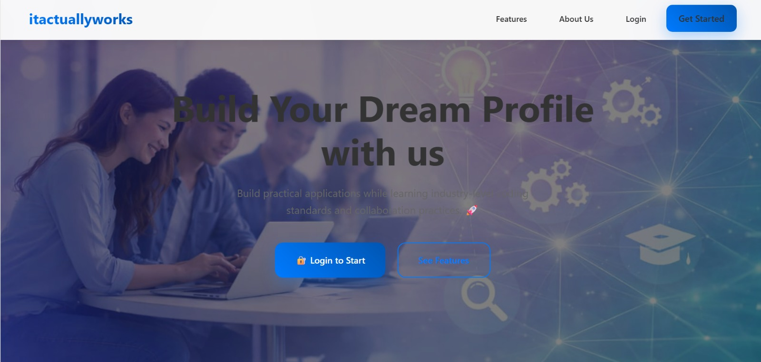
Home Page:

Slide 11
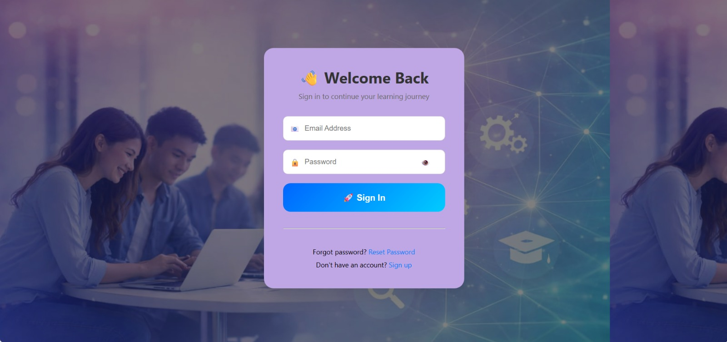
Login Page:

Slide 12
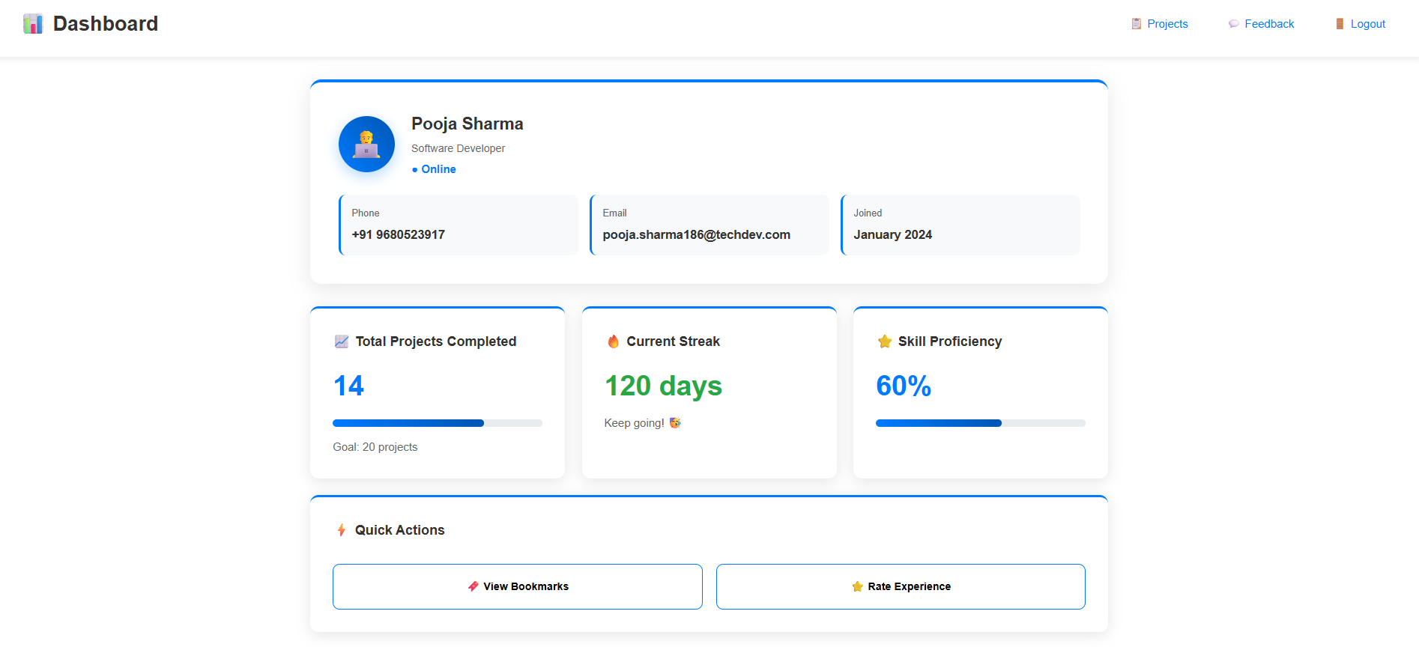
Dashboard:

Slide 13
Future Enhancements:
AI Chatbot guidance
Internship recommendations
Resume builder integration
Project collaboration feature
Machine learning-based smart prediction
Automated project report generation (PDF export)
Skill gap analysis with improvement suggestions
Industry-based project recommendations
GitHub integration for code submission and tracking
Notes:
This slide, The speaker will talk about the content that we will be covering in this session as follows:
Introduction
Importance of UI/UX in industry
History and Definitions of UI and UX
Key Differences between UI/UX
Use Cases
Significance in Web Development
Use Cases
Visual Design Principles
Design process
Color theory and psychology
Typography and readability
Layout and Spacing
Responsive design basics
Usability and Accessibility
Usability Aspects
Web Content Accessibility Guidelines (WCAG)
Inclusive design practices
Consistency
User Experience
User-Centered Design
User research methods
Interactive Elements and Feedback
Mini Case Study
Discussing a popular UI/UX design
Hands-On
Introduction to Figma for UI/UX design

Slide 14
Conclusion:
The Student Project Title Suggestion Website provides an effective solution for students who face difficulty in selecting appropriate project ideas. It offers organized and domain-relevant project suggestions that help students choose innovative and meaningful topics. By providing sample project ideas, structured guidance, and downloadable resources, the system supports better understanding, planning, and execution.
The platform promotes skill-based learning by aligning projects with individual capabilities and interests. It reduces confusion, saves time, and minimizes random or copied project selection. Additionally, the system improves confidence, encourages independent thinking, and enhances the overall quality of academic projects. Overall, this web-based application acts as a reliable and intelligent support system for structured and successful project development.

Slide 15
Reference :
Books:
https://www.apress.com/gp/book/9781430219361
https://www.twoscoopspress.com/products/two-scoops-of-django-3-x
https://docs.djangoproject.com
https://developer.mozilla.org
https://developer.mozilla.org/en-US/docs/Web
Online Reference:
Notes:
This slide, The speaker will talk about the content that we will be covering in this session as follows:
Introduction
Importance of UI/UX in industry
History and Definitions of UI and UX
Key Differences between UI/UX
Use Cases
Significance in Web Development
Use Cases
Visual Design Principles
Design process
Color theory and psychology
Typography and readability
Layout and Spacing
Responsive design basics
Usability and Accessibility
Usability Aspects
Web Content Accessibility Guidelines (WCAG)
Inclusive design practices
Consistency
User Experience
User-Centered Design
User research methods
Interactive Elements and Feedback
Mini Case Study
Discussing a popular UI/UX design
Hands-On
Introduction to Figma for UI/UX design

Slide 16


